Slide 1

Predicting
the S&P
Ryan McNeil & Craig Chosney
Spring 2024 CSc74020 ML Project

Slide 2
Project Topic
Financial Analytics is a rapidly evolving field
Intention is to build an algorithmic model to predict future stock price movement from S&P 500 market data
Can a model be built that outperforms similar models from research, which are now 5-10 years old?
Project builds on AI Finance Analytics research done by Ryan for Big Data Analytics course
Aim to utilize new/experimental models to achieve optimal performance

Slide 3
Dataset
Yahoo Finance
Chosen because it offers largest range of historical data for download (spanning back to 1972)
Dataset features include Date, Open, High, Low, Close, Adj Close, Volume, and Ticker
Many models train on 5 to 10 years worth of dated, wanted our models to span at least back to the 1990s, when large firms started experimenting with algorithmic trading
Wanted to capture less-common phenomena like the 2008 & 2020 recessions

Slide 4

Model 1

Slide 5





Methods
Five Individual Stocks Chosen
JPM — JP Morgan Chase (FINANCE)
LH — LabCorp (HEALTH CARE)
PG — Procter & Gamble (CONSUMER STAPLES)
VZ — Verizon (COMMUNICATION)
XOM — ExxonMobil (ENERGY)

Slide 6
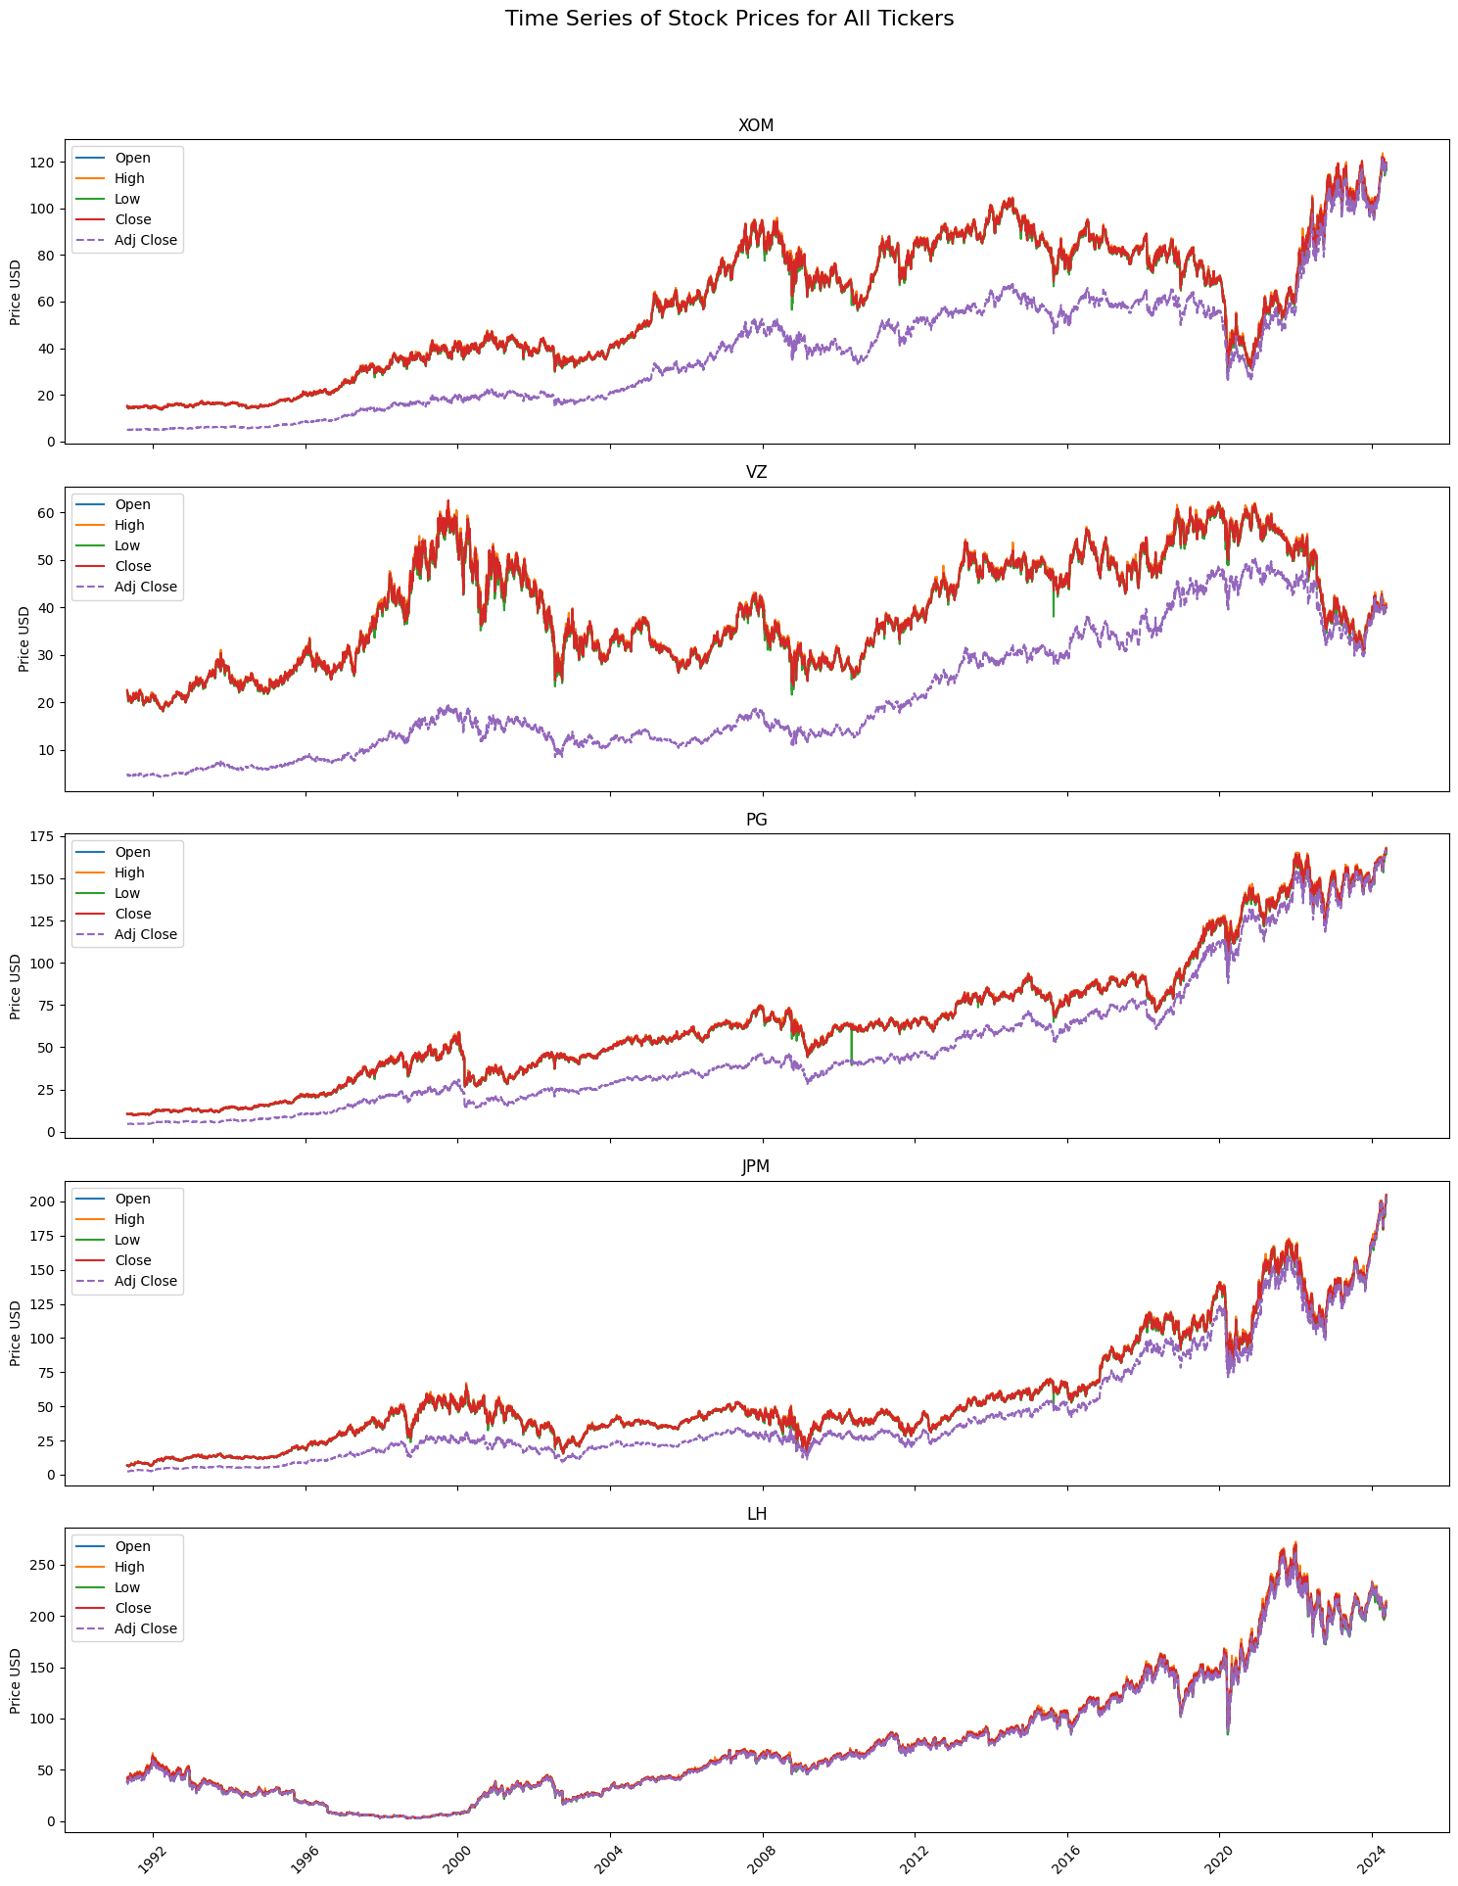
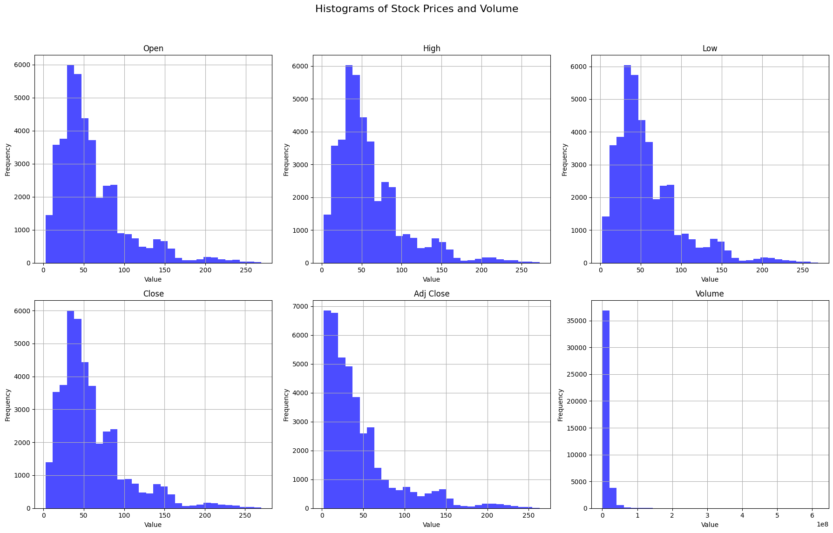
EDA
Histograms and Time Series

Slide 7
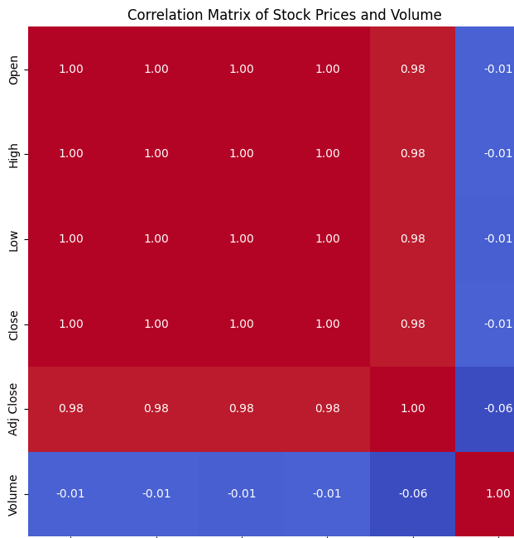
Correlation Matrix
High Correlations Among Price Attributes: expected because these attributes are different aspects of the same stock's trading activity and usually move together
High correlations among Open, High, Low, Close, and Adjusted Close suggests feature selection in modeling to avoid multicollinearity issues
‘Close’ dropped from modeling dataset

Slide 8
Feature Engineering
Implemented three fundamental techniques in time series analysis to improve predictive power by incorporating historical patterns and smoothing out data
Lag Features:
Created 7-day lag features by shifting the original time series data by 7 days
Rolling Window Functions
Created a 7-day rolling average for the close price
Created a 7-day rolling standard deviation for the close price
Exponential Moving Averages
Added Exponential Moving Average for 7 days

Slide 9
Target Variable Creation
Created a target variable ‘Next_Day_Close’ and a binary classification target ‘Market_Trend’
Compares ‘Next_Day_Close’ to ‘Close’. If the next day’s closing price is higher than the current day’s closing price, ‘Market_Trend’ is set to ‘1’, indicating an upward trend. Otherwise ‘Market_Trend’ is set to ‘0’.
This binary encoding process prepares the data for machine learning models that predict stock market trends based on past prices.

Slide 10
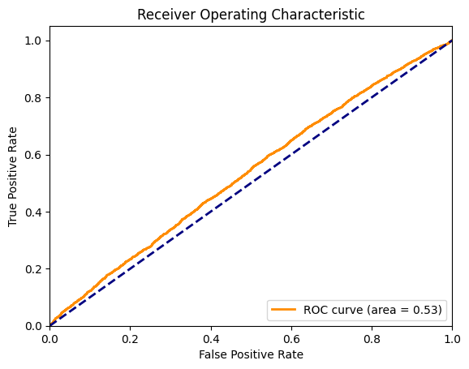
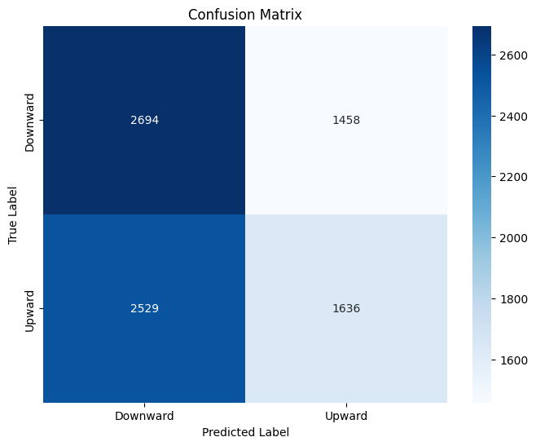
Models Utilized
Logistic Regression Model
Accuracy: 0.52
Precision: 0.53
Recall: 0.39
F1-Score: 0.45
ROC-AUC: 0.53

Slide 11
Models Utilized Continued
Decision Trees Model
Accuracy: 0.51
Precision: 0.51
Recall: 0.5
ROC-AUC: 0.51
Random Forest Model
Accuracy: 0.51
Precision: 0.52
Recall: 0.48
ROC-AUC: 0.52
Support Vector Machine Model
Accuracy: 0.51
Precision: 0.52
Recall: 0.35
ROC-AUC: 0.53
K-Nearest Neighbors Model
Accuracy: 0.51
Precision: 0.51
Recall: 0.49
ROC-AUC: 0.51

Slide 12
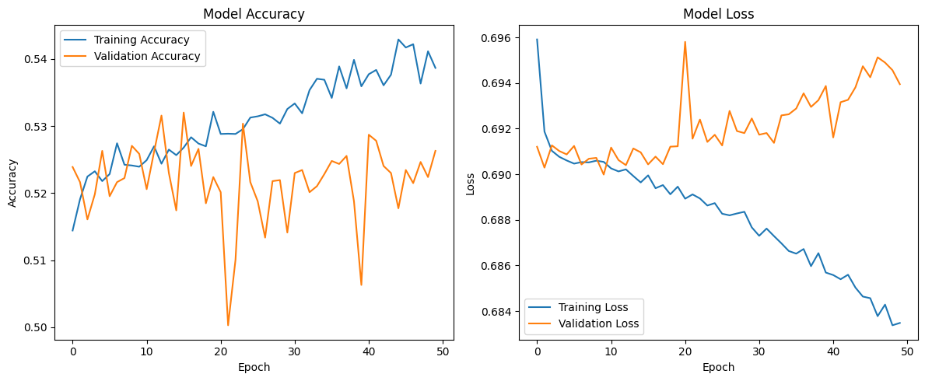
Neural Networks Model
Test Loss: 0.70
Test Accuracy: 0.53
Precision: 0.52
Recall: 0.56
AUC: 0.54

Slide 13
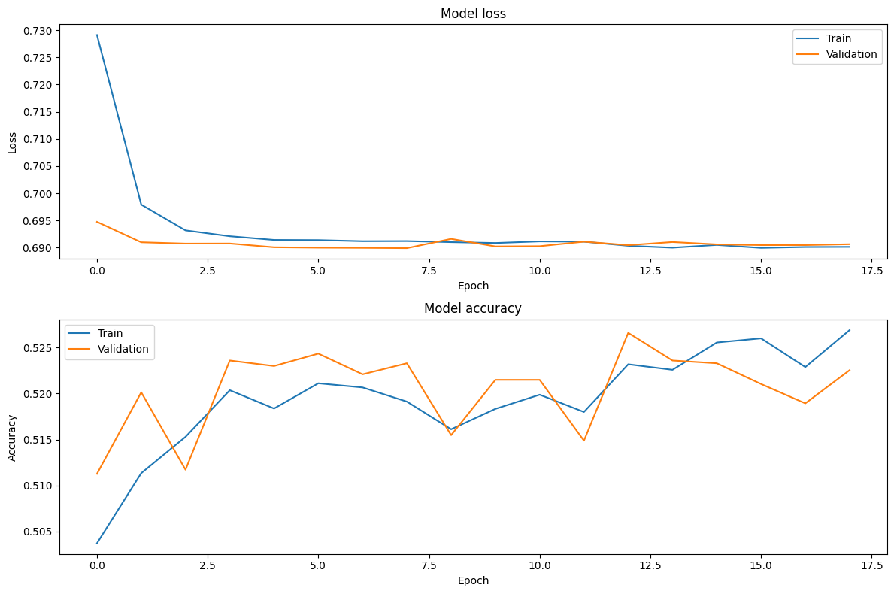
Neural Networks Model — After Enhancement
Test Loss: 0.69
Test Accuracy: 0.52
Precision: 0.52
Recall: 0.71
AUC: 0.53

Slide 14
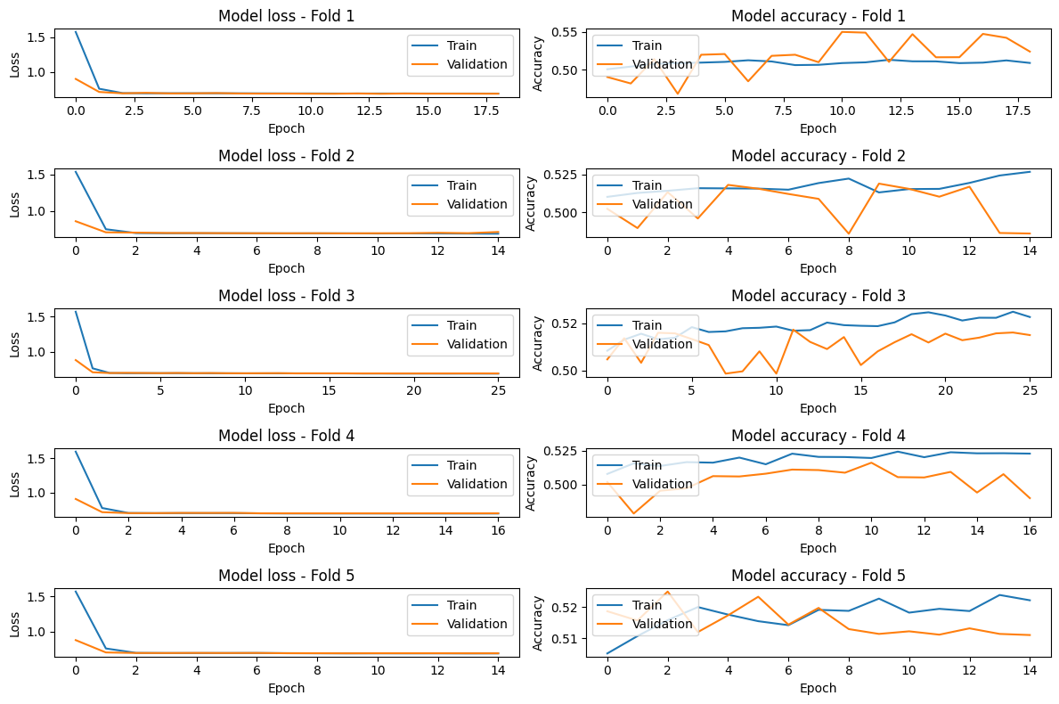
Cross-
Validation

Slide 15

Analysis & Evaluation
With accuracy values around 0.50, model performance is only marginally better than random guessing for a binary classification task.
Models perform only slightly better than random guessing.
Can Model 2 provide more predictive power?

Slide 16
Model 2

Slide 17
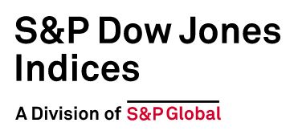

Methods
SPX Market Index chosen
Open, close, high, low, adjusted close, volume.
I experiment with other variables, including a “day average”, but ultimately opted to drop these.
We create 7 lag terms each for all of the remaining variables, totaling 40 features.

Slide 18
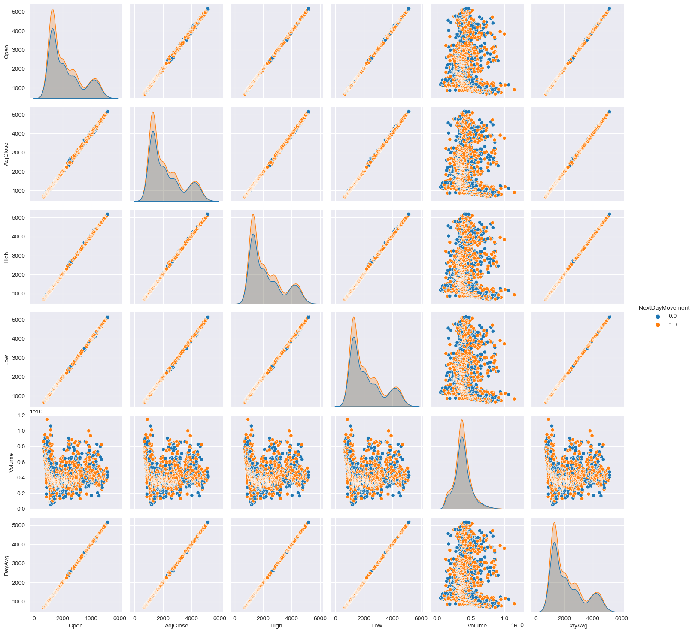
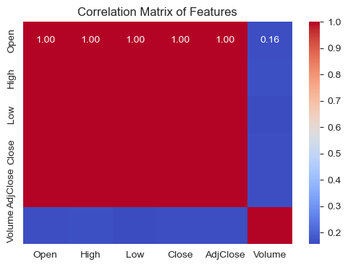
Methods
From these 8 days’ (last 7 days + current day) of data, we aim to predict next-day market performance.
We first experimented with predicting next-day market direction (up vs down), but this proved difficult to predict (best model AUC ≈ 0.61).

Slide 19
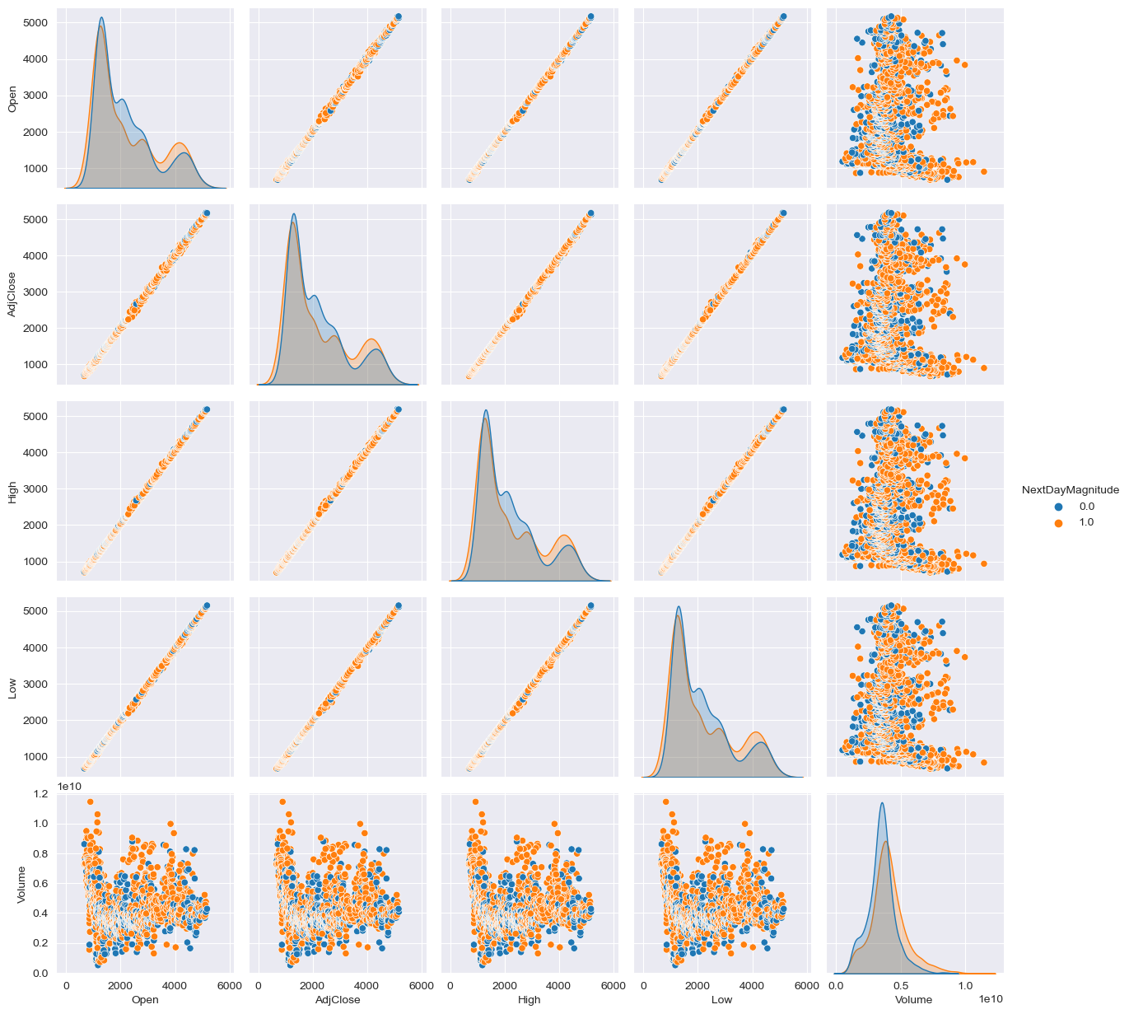
Methods
Instead, we changed targets to next-day magnitude.
We will try to predict whether the market will shift ≥50 basis points.
In other words, will the market shift in some direction by 0.5% or more the next day.
Chosen because it yields an even class distribution.

Slide 20
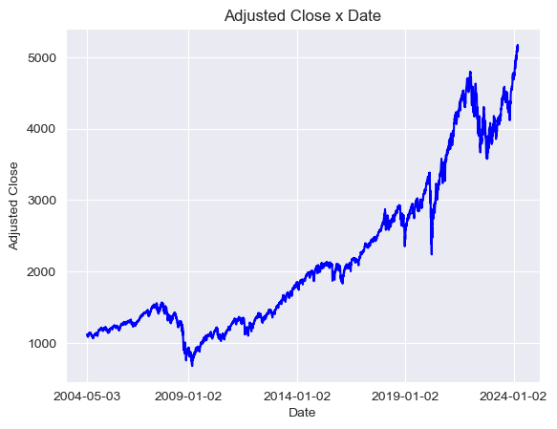
EDA
Initial dataset has nearly 100 years of data.
Historic changes in economic structures and measurement.
Data prior to 1961 contains the same value for high/low/open/close.
No proper open values until 1982.
Financialization (1980s) & introduction of algorithmic trading (1990s-2000s) restructured markets and may have altered the way markets behave.
Start point of May 2004 chosen to match time range of model 1.

Slide 21
EDA
Redundant variables:
We drop date so that our model is not simply predicting historic performance by memorizing dates.
We drop close, in favor of only using adjusted close, since these will likely be very similar.

Slide 22
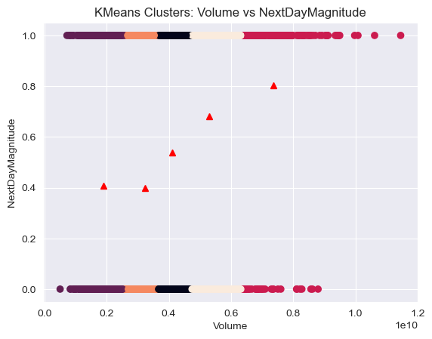
Clustering
We did not expect to find meaningful clusters in our data, but we investigated anyway.
Volume is the one variable that yielded anything worth noting. Higher next-day magnitudes seem to associate with higher current-day volume.

Slide 23
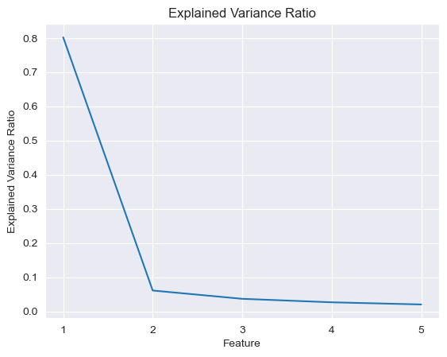
Scaling & Dimensionality Reduction
We create 2 additional X datasets:
One scaled with mean & stdv.
One reduced to one feature by PCA
Initially tried reducing to 5 features (see right).

Slide 24
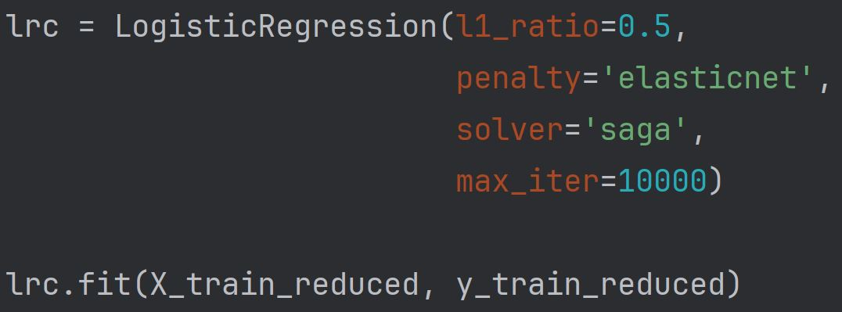
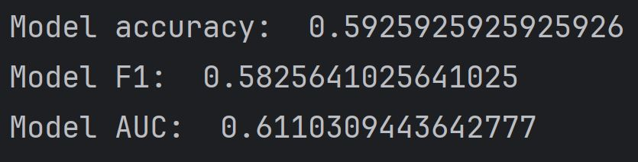
Logistic Regression Model
Optimized LogReg classifier
Logistic regression performs poorly on both the original and dimensionally-reduced data.
Optimized model achieves max training AUC ≈ 0.61.
Logistic regression does not necessitate feature scaling, and using the scaled data does not improve performance.

Slide 25
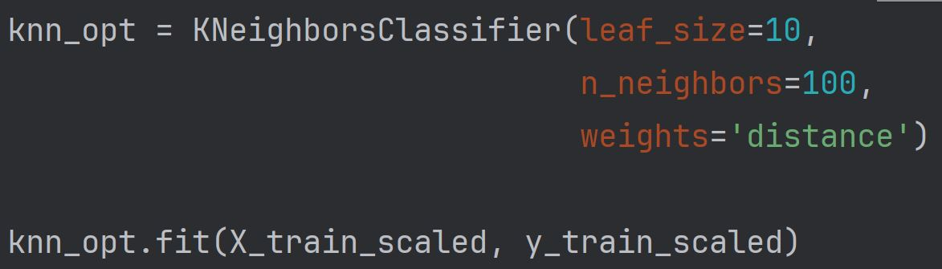
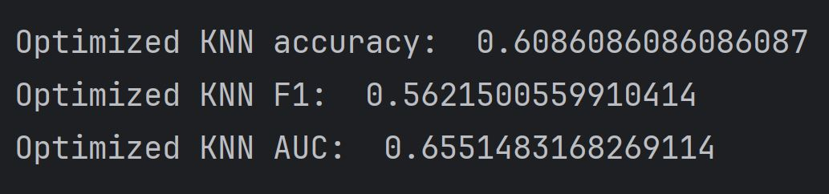
KNN Model
Optimized KNN
KNN model performs poorly on the reduced data & only as well as the LogReg model on the original data.
KNNs can benefit from scaling, and our optimized model using scaled data achieves max training AUC ≈ 0.66.

Slide 26
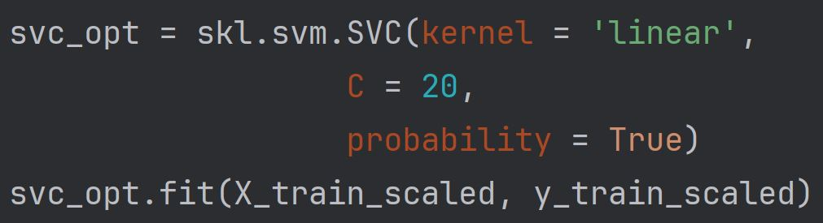
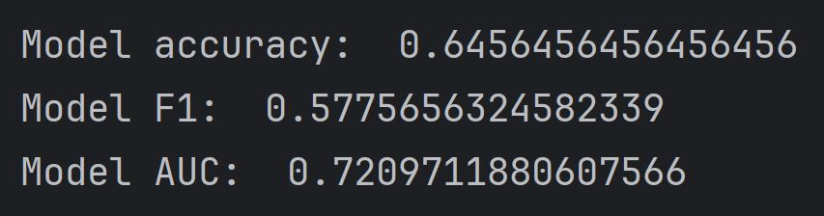
Support Vector Machine Model
An SVM classifier produces our strongest model so far in terms of AUC & accuracy, but not in terms of F1. AUC ≈ 0.72.
This strong performance may be partially attributed to SVMs strength with high-dimensional data.
Notably, a linear kernel outperforms alternative kernel types, implying most of the “signal” in our data lies in linear (vs non-linear) trends.
Optimized SVC

Slide 27


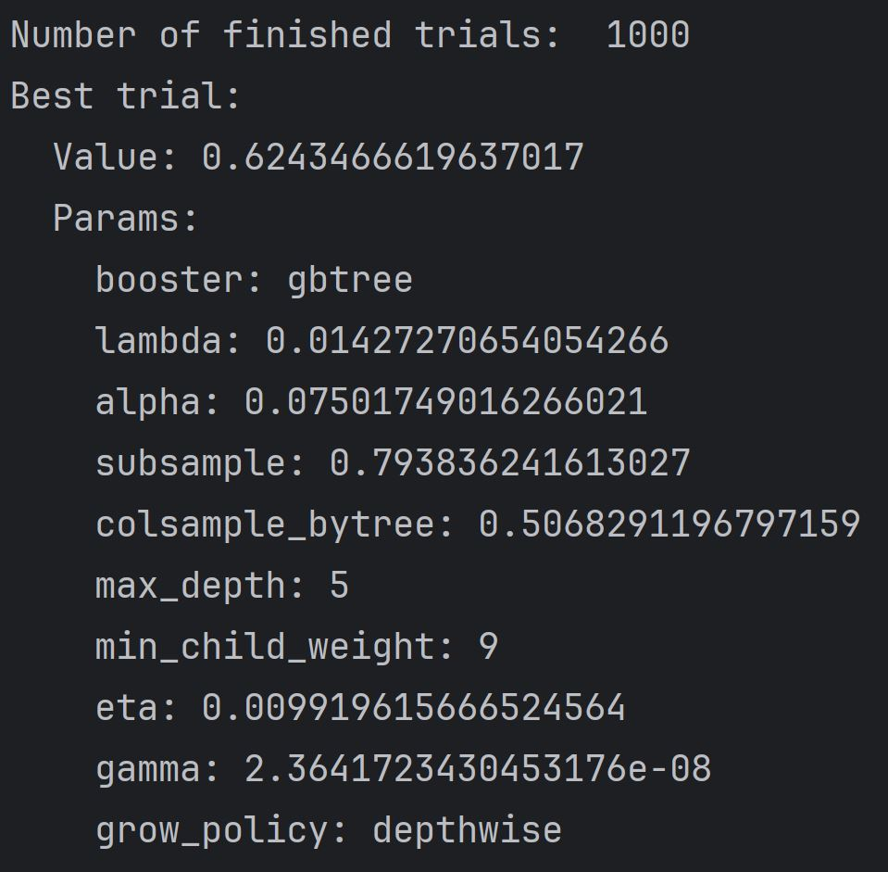
XGBoost Model
Plus, Feature Importances
XGBoost optimized with Optuna only achieves AUC ≈ 0.62.
Tree-based methods may perform poorly on high-dimensional data and are also prone to overfitting with high-dimensional data.
Tree-based methods may not capture linear relationships as well as other methods (reaffirming our intuition from the SVM model performance).

Slide 28
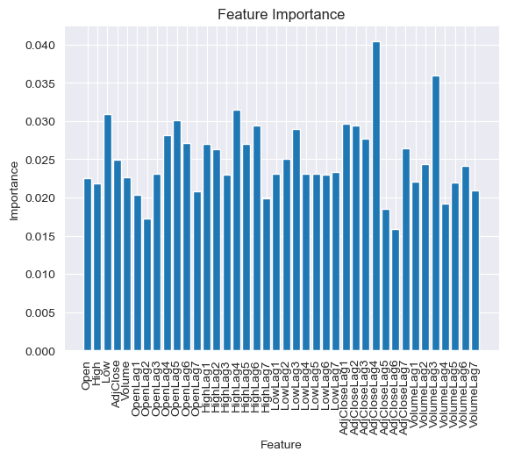
XGBoost Model
Plus, Feature Importances
We also took this opportunity to inspect feature importances.
Relatively distributed.
AdjustedClose Lag4 & Volume Lag3 most important.
Across all variables, Lag3 to Lag4 appears to be most significant.

Slide 29
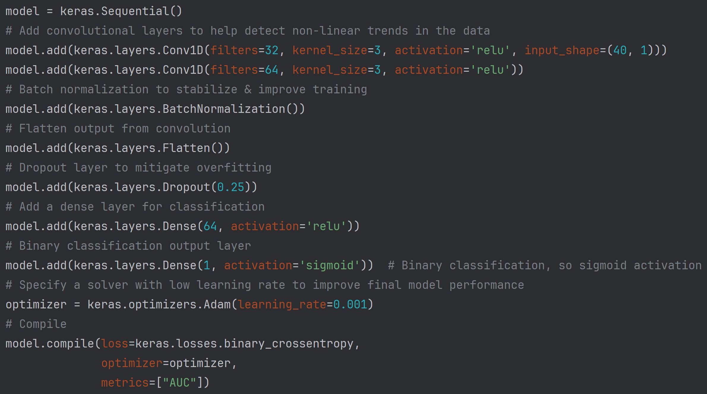
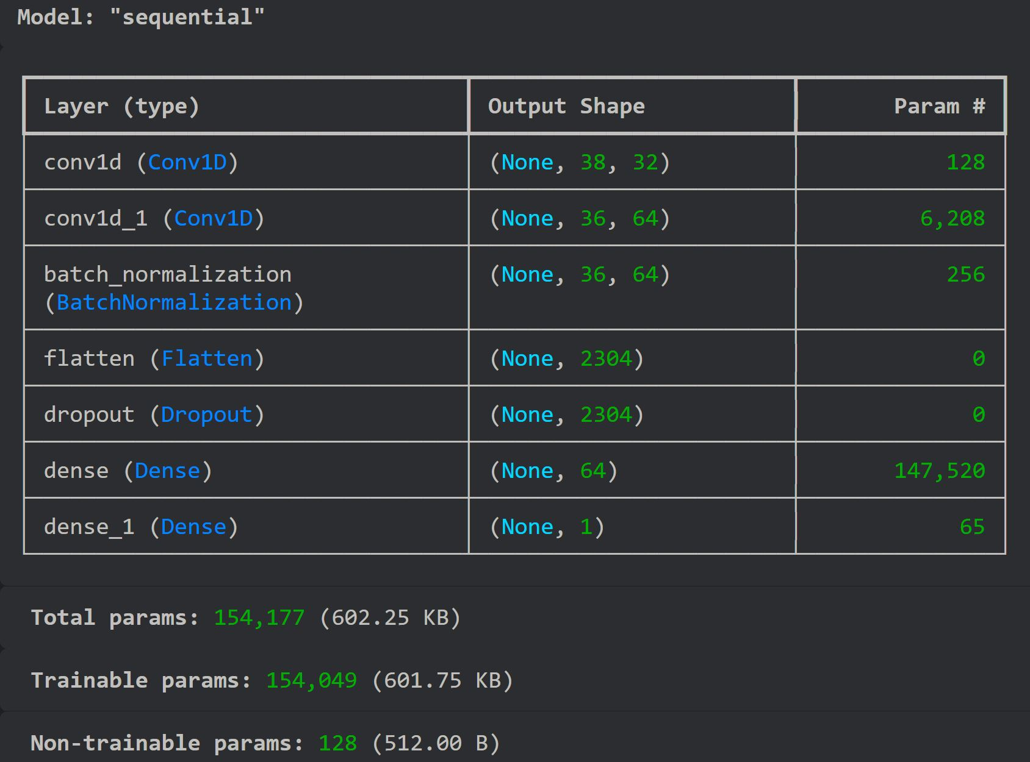
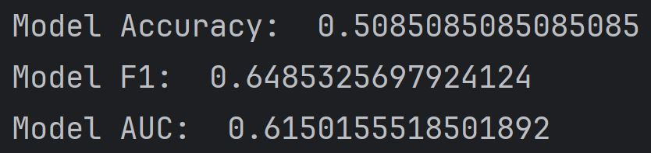
Neural Network Model
Convolutional neural network performed better than a basic neural network, but not by much. This model does not significantly outperform our other models. AUC ≈ 0.62.
Convolution Layer: non-linear trends
Batch normalization: stabilize & improve training
Flatten convolution output
Dropout layer: mitigate overfitting
Dense layers with relu activation
Binary classification dense layer with sigmoid activation.
Adam solver with low learning rate, compiled with binary crossentropy loss on AUC metric.

Slide 30
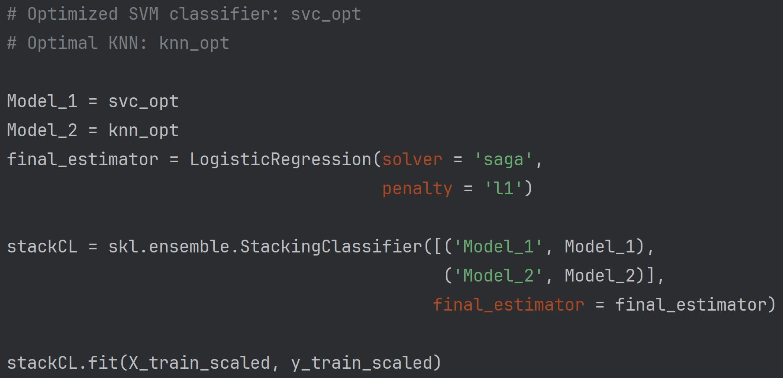
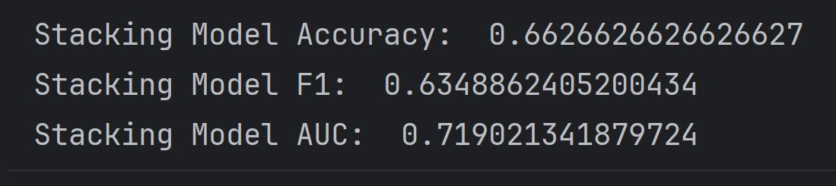
Model Stacking
I stack our 2 best models for experimentation sake.
Final estimator: simple LogReg with L1 regularization.
Only performs about as well as our existing optimal model.

Slide 31
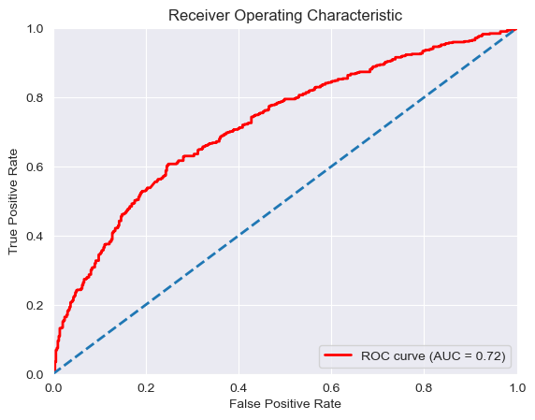
Model 2 Final Optimized
We take our SVM classifier optimized & trained on scaled data as our best model.
Relatively even ROC curve with AUC ≈ 0.72.
Given the nature of our classification task, both false positives and false negatives can be equally dangerous, depending on how one is trading.

Slide 32
Appendix

Slide 33
Model 1 Analysis & Evaluation
Loss Analysis: Rapid decrease in training and validation loss within the first few epochs in all folds indicates that the model quickly learns some basic patterns in the data. After the initial decrease, the training loss stabilizes, but the validation loss fluctuates significantly across epochs. The validation loss in some folds starts to diverge from the training loss, which is a sign of overfitting. These patterns suggest that the model is learning specific patterns from the training data that do not generalize well to the validation data.
Accuracy Analysis: The training accuracy tends to stabilize around 0.52 to 0.55 across different folds, indicating a consistent performance on the training data. The validation accuracy fluctuates more compared to the training accuracy. This variability suggests that the model's performance on unseen data is not stable and might be sensitive to the specific split of the data. With accuracy values around 0.50, the model's performance is only marginally better than random guessing for a binary classification task.
Recommendations for Improvement: Increase Data Volume: More training data might help the model to generalize better and reduce overfitting. Increased Feature Engineering: Add more informative features or using advanced feature engineering techniques might help in improving model performance. Regularization Techniques: Increase dropout rates to prevent the model from overfitting or applying L2 regularization to penalize large weights and encourage the model to find simpler patterns. Model Architecture: Experiment with different architectures (e.g., more layers, different activation functions) might improve performance. Data Augmentation: For time-series data, techniques such as jittering, scaling, and window slicing can be used to artificially increase the size of the dataset.

Slide 34
References
[1] A. Fuster & Z. Zou “Using Machine Learning Models to Predict S&P500 Price Level and Spread Direction.”
[12] J. Wu. “A Pairs Trading Strategy for GOOG/GOOGL Using Machine Learning.”
[3] R. W. J. van der Have “Pairs Trading Using Machine Learning: An Empirical Study.” Erasmus University Thesis Repository.
[4] A. Gueron. “Hands-On Machine Learning with Scikit-Learn and TensorFlow: Concepts, Tools, and Techniques to Build Intelligent Systems.” 3nd Edition.
[5] A. G. Barto, R. S. Sutton. “Reinforcement Learning: An Introduction.” MIT Press.
[6] S. Ahmed, M. M. Alshater, A. El Ammari, H. Hammami, “Artificial intelligence and machine learning in finance: A bibliometric review,” Research in International Business and Finance, vol. 61, Apr 2022.
[7] “Artificial Intelligence, Machine Learning and Big Data in Finance: Opportunities, Challenges and Implications for Policy Makers”, OECD, 2021.
[8] “Finance and Financial Data”, NYU Libraries. 2023.
[9] E. Boehmer, K. Fong, J. Wu, “Algorithmic Trading and Market Quality: International Evidence,” Journal of Financial and Quantitative Analysis, vol. 56, no. 8, Dec 2021.
[10] F. G. D. C. Ferreira, A. H. Gandomi, R. T. N. Cardoso, “Artificial Intelligence Applied to Stock Market Trading: A Review,” IEEE Access, Jan 2021.
[11] P. Sonkiya, V. Bajpai, A. Bansal, “Stock Price Prediction Using Artificial Intelligence: A Survey.” IEEE, Apr 2022.
[12] C. Li, L. Shen, G. Qian, “Online Hybrid Neural Network for Stock Price Prediction: A Case Study of High-Frequency Stock Trading in the Chinese Market,” Econometrics, vol. 11, no. 13, May 2023.
[13] F. Soleymani, E. Paquet, “Financial portfolio optimization with online deep reinforcement learning and restricted stacked autoencoder—DeepBreath,”
Expert Systems with Applications, vol. 156, Apr 2022.
[14] M. B. Schrettenbrunner, “Artificial-Intelligence-Driven Management: Autonomous Real-Time Trading and Testing of Portfolio or Inventory Strategies,” IEEE Engineering Management Review, vol. 51, no. 3, Sept 2023.
[15] H. Haddadian, M. B. Haskuee, G. Zomordian, “A Hybrid Artificial Intelligence Approach to Portfolio Management,” Iranian Journal of Finance, vol. 6, no.
1, pp. 1-27, Feb 2022.
[16] J. W. Yeo, W. Van Der Heever, M. Rui, E. Cambria, R. Satapathy, G. Mengaldo, “A Comprehensive Review on Financial Explainable AI,” Journal of the Association for Computing Machinery, vol. 37, no. 4, Aug 2023.
[17] S&P500 Index. Yahoo Finance. https://finance.yahoo.com/quote/%5ESPX/history?period1=-1325635200&period2=1710633600&interval=1d&filter=history&frequency=1d&includeAdjustedClose=true

